Slide 1
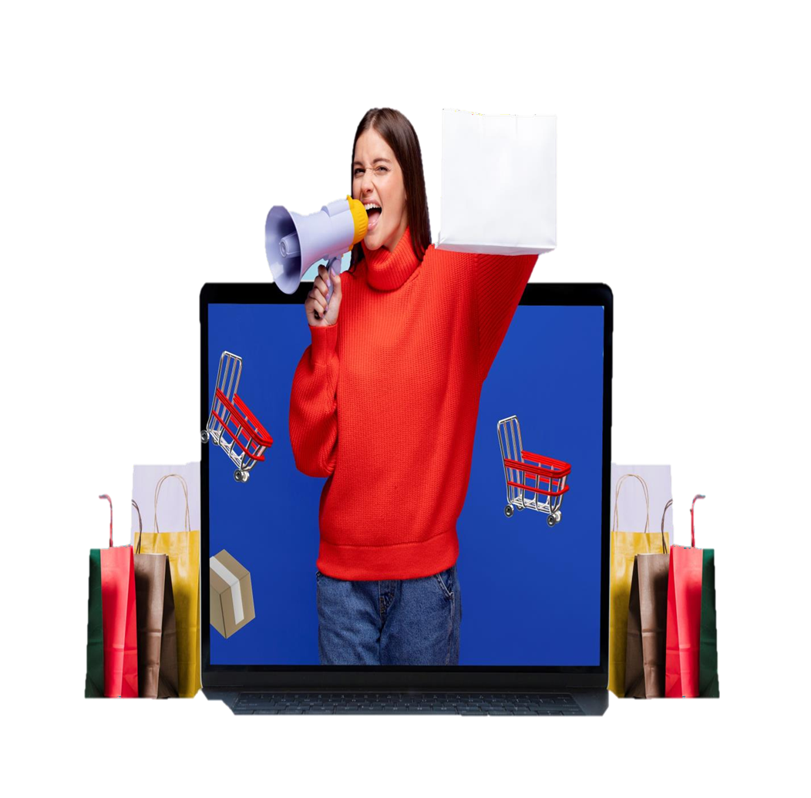
Rupashree Store Annual Report 2023
By Sayantan Ghosh

Slide 2
Problem Statement
Rupashree Store, an online retailer specializing in clothing categories such as kurtas, sarees, sets, tops, western dresses, blouses, bottoms, and ethnic dresses, operates across multiple e-commerce channels including Ajio, Myntra, Amazon, Flipkart, Meesho, Nykaa, and others. Rupashree Store seeks to create a detailed Annual Sales Report for 2023 to enhance its understanding of existing customer behavior and identify growth opportunities3. This report will analyze sales performance by category and channel, uncover customer insights, and provide actionable recommendations to boost sales and expand its customer base in 2024.

Slide 3
1. Compare the Sales and Orders using single chart 2. Mention the month got the Highest Sales and Orders 3. Mention Men or women who purchase most in 2023 4. Top 10 States contributing the Sales most 5. Relation between Age and Gender 6. Mention the Channel , according to Maximum Sales 7. Mention the Highest Selling Category 8. Top 10 Cities Contributing the Sales most
TASK
As a data analyst, I aim to craft a dynamic dashboard that transforms Rupashree Store's 2023 sales data into actionable insights, empowering smarter decisions and unlocking new growth opportunities for 2024.

Slide 4
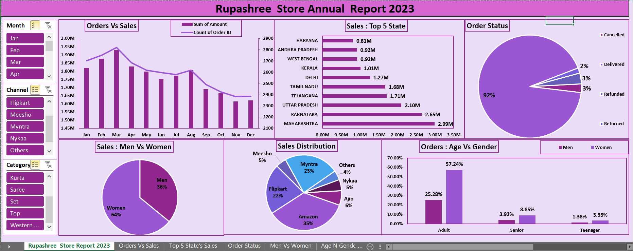
Dashboard

Slide 5
Compare the Sales and Orders using a single chart

Slide 6
Highest Sales and Orders Month
March has the highest number of orders 2.8K and sales 1.95M Followed by February and Apr with 1.90M and 1.85M sales.
March is often a transitional month from winter to summer, People may update their wardrobes to suit the changing weather conditions, leading to increased clothing sales.
New Year Celebration held in March in diff names like Naba Barsho,Pongal,Gudi Padwa people prefer to buy new clothes to wear during the celebrations.
The peak wedding season typically falls during the months of November to March.

Slide 7
Purchase : Men Vs Women
Most of the sales happened by the women’s 13.56M and men’s are half of women 7.61M.
Fashion Consciousness: Women on average, tend to be more fashion- conscious and aware of the latest trends in clothing.
Occasional Shopping: Women may engage in more frequent shopping trips, especially for special occasions like weddings, festivals, parties, and family gatherings.
Different Seasons: As mentioned earlier, March marks the transition from winter to spring in many regions. Women may seek to update their wardrobe with appropriate clothing for the changing weather.

Slide 8
Top 10 States Contributing the Sales most
1
2
Maharashtra has the highest number of orders 4.5k followed by Karnataka and U.P. with 4k and 3k.
Haryana, Andhra Pradesh, and West Bengal have less numbers of orders.
Population Density: These three states, Maharashtra, Karnataka, and Uttar Pradesh, are among the most populous states in India.
Festivals and Celebrations: These states have diverse cultural festivals a celebrations throughout the year, prompting people to buy new clothes.

Slide 9
Relation between Age and Gender
1
2
Most of the orders came from Adult where Women 57.24% and Men 25.28%.
Teenager contributed around 5% where women 3.33% & Men 1.38%.
Senior Citizens contributed around around 14% where Women 8.85% & Men 3.92%.

Slide 10
Maximum Sales according to the Channel
1
2
Most of the orders came from Amazon at 35% , followed by Myntra at 23% and Flipkart at 22%.
The very few orders came from Ajio 6% and Nalli 5%.
Brand Recognition: Amazon is a global E-commerce giant with a strong brand presence and customer trust.
Prime Membership: Amazon,Flipkart
and Myntra offers several benefits , such as fast and free shipping, exclusive deals, and access to streaming services.

Slide 11
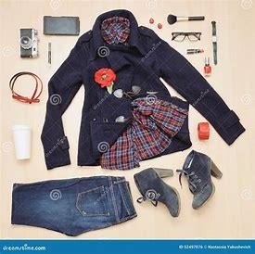
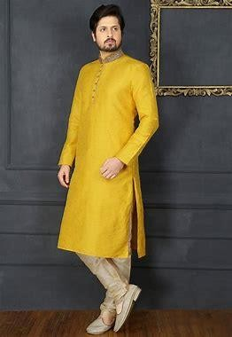
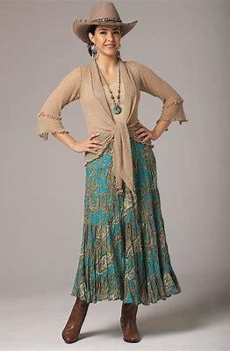
Most Selling Category
1
The most sold category is Set 12391 pics out of 31047 pics it is around 40% of the total sales.
Kurta and Western dress is the second and third highest category with 10446 pics and 4066 pics.
The most less sold categories are Bottom, Blouse, Ethnic dress & so on.

Slide 12
Top 10 Cities Contributing the Sales Most
Most of the sales happened in Bengaluru city at 1.77M.
Hyderabad, New Delhi is the second and third place with 1.37M and 1.16M sales.
Online Shopping: Urban consumers are more likely to engage in online shopping, leading to increased sales on online platforms.
Fashion Consciousness: Urban centers tend to be more fashion-conscious, with consumers keen on keeping up with the latest trends and styles.

Slide 13
Key Insights
Peak Sales Month is March and Sales Amount is 1.93M.
Women are more likely to buy compared to men (~65%)
The most sold category is Set 12391 pics out of 31047 pics it is around 40% of the total sales
Maharashtra, Karnataka, and Uttar Pradesh are the top 3 states (~35%)
The adult age group (19-60 yrs) is max contributing (~50%)
Amazon , Flipkart and Myntra channels are more contributing (~80%)

Slide 14
Recommendations
Target Men customers of the age group (30-60 Yrs) that is Adults living in Maharashtra, Karnataka and Uttar Pradesh etc. by showing ads , offers , coupons available on Amazon , Flipkart and Myntra and adding more Creative , simple & sustainable Inventory for Men’s Fashion
Target Women customers of the age group (30-60 Yrs) that is Adults living all states apart from Maharashtra, Karnataka and Uttar Pradesh etc. by showing ads , offers , coupons available on Amazon , Flipkart and Myntra and adding more Creative , Colourful , Fashionable , simple & sustainable inventory for Women’s Fashion.

Slide 15


Thank You for Your Attention!
We Appreciate Your Time!
Do you have any questions?
ghoshsayantan090@gmail.com
I’m happy to answer any questions or discuss further!

